Slide 1

Introduction to OpenMP
CSC4010
David Cutting – d.cutting@qub.ac.uk

Slide 2
Implementing Parallel Programming
We’ve talked about parallel in general, now we’re going to look at implementing parallel in code.
Memory Models
OpenMP

Slide 3
Memory Models

Slide 4

Shared Memory
All processors have access to the same memory (a pool of common memory)
Data is exchanged by writing/reading from this pool
Memory Pool

Slide 5
Shared Memory Classes
Symmetric Multiprocessor (SMP)
  Shared address space with unform access i.e. each processor given equal time access, memory regions treated the same.
Non-Uniform Address Space (NUMA)
  Memory spread onto different areas (or types) with different “costs” to access (usually categorised as “near” or “far”) – can be used as abstracted shared memory model on parallel HPC (closely coupled with high speed network).

Slide 6
Issues with Shared Memory
Limited in scale – more processors means more time waiting for access
Memory bus becomes congested slowing all system processes down
More processors = more problems maintaining cache

Slide 7
Introduction to OpenMP

Slide 8
“The OpenMP API supports multi-platform shared-memory parallel programming in C/C++ and Fortran. The OpenMP API defines a portable, scalable model with a simple and flexible interface for developing parallel applications on platforms from the desktop to the supercomputer.” – openmp.org
“OpenMP (Open Multi-Processing) is an application programming interface (API) that supports multi-platform shared-memory multiprocessing programming in C, C++, and Fortran, on many platforms, instruction-set architectures and operating systems, including Solaris, AIX, FreeBSD, HP-UX, Linux, macOS, and Windows. It consists of a set of compiler directives, library routines, and environment variables that influence run-time behavior.” – Wikipedia

Slide 9
“The OpenMP API supports multi-platform shared-memory parallel programming in C/C++ and Fortran. The OpenMP API defines a portable, scalable model with a simple and flexible interface for developing parallel applications on platforms from the desktop to the supercomputer.” – openmp.org
“OpenMP (Open Multi-Processing) is an application programming interface (API) that supports multi-platform shared-memory multiprocessing programming in C, C++, and Fortran, on many platforms, instruction-set architectures and operating systems, including Solaris, AIX, FreeBSD, HP-UX, Linux, macOS, and Windows. It consists of a set of compiler directives, library routines, and environment variables that influence run-time behavior.” – Wikipedia

Slide 10
“The OpenMP API supports multi-platform shared-memory parallel programming in C/C++ and Fortran. The OpenMP API defines a portable, scalable model with a simple and flexible interface for developing parallel applications on platforms from the desktop to the supercomputer.” – openmp.org
“OpenMP (Open Multi-Processing) is an application programming interface (API) that supports multi-platform shared-memory multiprocessing programming in C, C++, and Fortran, on many platforms, instruction-set architectures and operating systems, including Solaris, AIX, FreeBSD, HP-UX, Linux, macOS, and Windows. It consists of a set of compiler directives, library routines, and environment variables that influence run-time behavior.” – Wikipedia

Slide 11
Fork-Join Model
OpenMP uses the “fork—join” model which is a common model in parallel programming (a parallel design pattern in fact)
The main (sequential) thread branches off into multiple threads of execution to then re-join (merge back) at a set point, usually once the work is completed

Slide 12
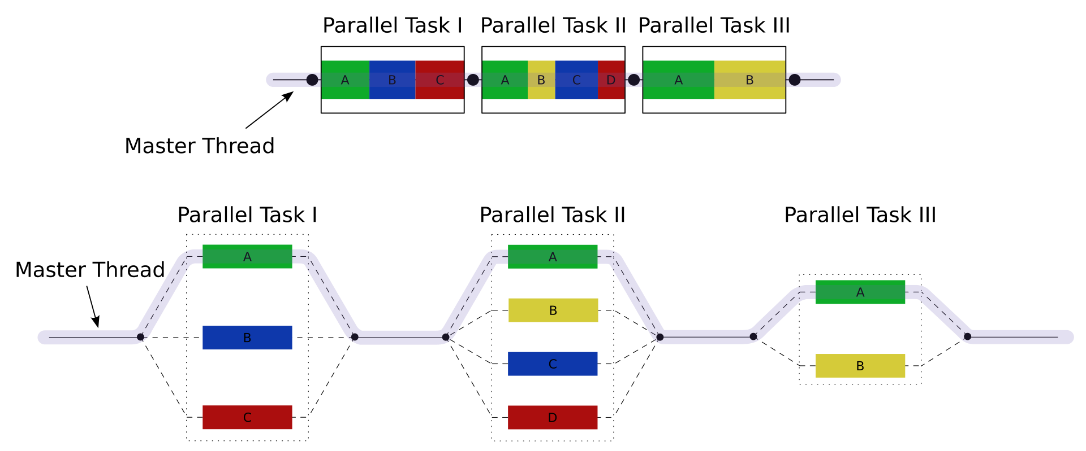
Fork-Join Model
Source: Wikipedia.org

Slide 13
OpenMP
With OpenMP parallel sections of code are marked using compiler directives
These are then executed by teams of threads
There are a myriad of options as to how these are run (thread numbers, shared or private variables, scheduling…) and many ways to handle things like concurrent locking and atomic updates

Slide 14
OpenMP in C
Include the library
#include <omp.h>
Tell the compiler and linker to use the library
-fopenmp
Use pragma compiler directives in code
#pragma omp parallel
Use omp_ methods in code
omp_get_thread_count();

Slide 15
OpenMP First Demo

Slide 16

?
?
?
?
?
?
?
?
?
?
?

